Slide 1


Slide 2
Living Faith

Slide 3
Hebrews 12:28-29 Wherefore we receiving a kingdom which cannot be moved, let us have grace, whereby we may serve God acceptably with reverence and godly fear: 29 For our God is a consuming fire.

Slide 4
What does it look like to live by faith in God’s Word?

Slide 5
You get God’s heart
of love for others!

Slide 6
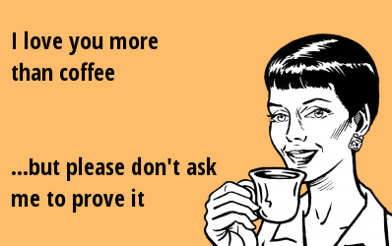

BY FAITH
YOU LOVE THE CHURCH.
Problem today:
“I love you, because I
have to.
But, I don’t like you.”

Slide 7
1 John 4:7-11 Beloved, let us love one another: for love is of God; and every one that loveth is born of God, and knoweth God. 8 He that loveth not knoweth not God; for God is love. 9 In this was manifested the love of God toward us, because that God sent his only begotten Son into the world, that we might live through him. 10 Herein is love, not that we loved God, but that he loved us, and sent his Son to be the propitiation for our sins. 11 Beloved, if God so loved us, we ought also to love one another.

Slide 8
BY FAITH
LOVING IS HOW GOD HAS DESIGNED US TO LIVE!
The fruit of the Spirit is love! Galatians 5:22
Love given to your brethren a first fruit in the life of a new believer!
2 Peter 1:5-7 Love is where our faith culminates.

Slide 9
We protect unity.

Slide 10
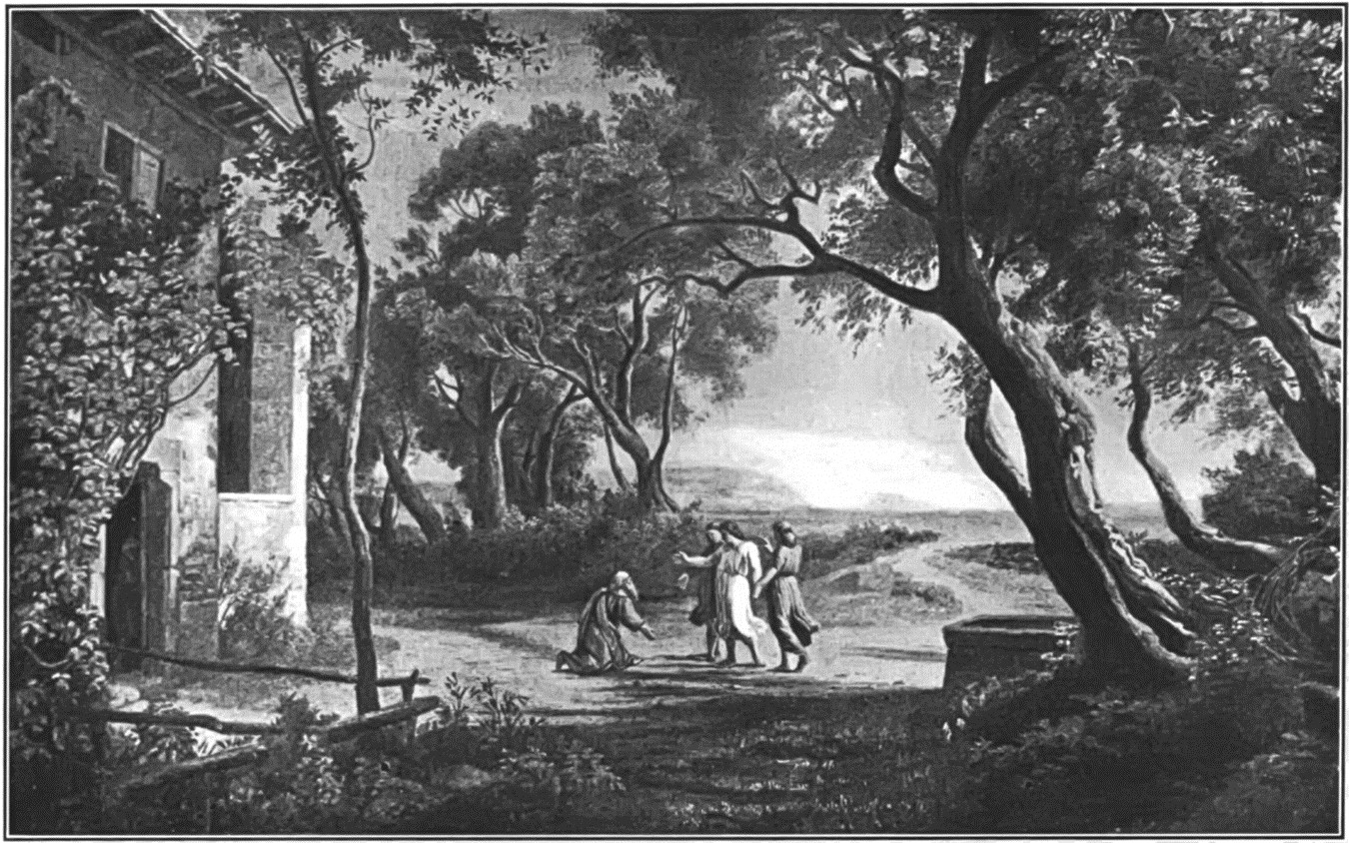
BY FAITH
YOU LOVE THE
STRANGER.
To make ready
for others and
invest in them
is how faith lives.

Slide 11
1 Peter 4:8-9 And above all things have fervent charity among yourselves: for charity shall cover the multitude of sins. 9 Use hospitality one to another without grudging.

Slide 12
Mat 7:12 Therefore all things whatsoever ye would that men should do to you, do ye even so to them: for this is the law and the prophets.
Mat 25:35 For I was an hungred , and ye gave me meat : I was thirsty , and ye gave me drink : I was a stranger, and ye took me in :
Rom 12:17 Recompense to no man evil for evil. Provide things honest in the sight of all men.

Slide 13
2 Corinthians 5:14-16 For the love of Christ constraineth us; because we thus judge, that if one died for all, then were all dead: 15 And that he died for all, that they which live should not henceforth live unto themselves, but unto him which died for them, and rose again. 16 Wherefore henceforth know we no man after the flesh: yea, though we have known Christ after the flesh, yet now henceforth know we him no more.

Slide 14
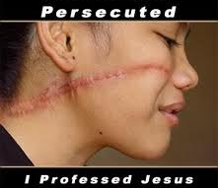
BY FAITH
YOU LOVE THE SUFFERER.
Know God’s heart for His!

Slide 15
Matthew 25:31-46 When the Son of man shall come in his glory, and all the holy angels with him, then shall he sit upon the throne of his glory: ³² And before him shall be gathered all nations: and he shall separate them one from another, as a shepherd divideth his sheep from the goats: ³³ And he shall set the sheep on his right hand, but the goats on the left. ³⁴ Then shall the King say unto them on his right hand, Come, ye blessed of my Father, inherit the kingdom prepared for you from the foundation of the world: ³⁵ For I was an hungred, and ye gave me meat: I was thirsty, and ye gave me drink: I was a stranger, and ye took me in: ³⁶ Naked, and ye clothed me: I was sick, and ye visited me: I was in prison, and ye came unto me. ³⁷ Then shall the righteous answer him, saying, Lord, when saw we thee an hungred, and fed thee? or thirsty, and gave thee drink? ³⁸ When saw we thee a stranger, and took thee in? or naked, and clothed thee? ³⁹ Or when saw we thee sick, or in prison, and came unto thee?

Slide 16
⁴⁰ And the King shall answer and say unto them, Verily I say unto you, Inasmuch as ye have done it unto one of the least of these my brethren, ye have done it unto me. ⁴¹ Then shall he say also unto them on the left hand, Depart from me, ye cursed, into everlasting fire, prepared for the devil and his angels: ⁴² For I was an hungred, and ye gave me no meat: I was thirsty, and ye gave me no drink: ⁴³ I was a stranger, and ye took me not in: naked, and ye clothed me not: sick, and in prison, and ye visited me not. ⁴⁴ Then shall they also answer him, saying, Lord, when saw we thee an hungred, or athirst, or a stranger, or naked, or sick, or in prison, and did not minister unto thee? ⁴⁵ Then shall he answer them, saying, Verily I say unto you, Inasmuch as ye did it not to one of the least of these, ye did it not to me. ⁴⁶ And these shall go away into everlasting punishment: but the righteous into life eternal.

Slide 17
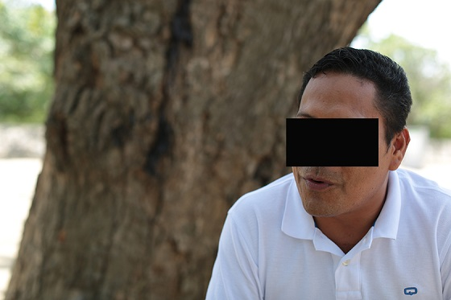

Slide 18
Living Faith

